Slide 1
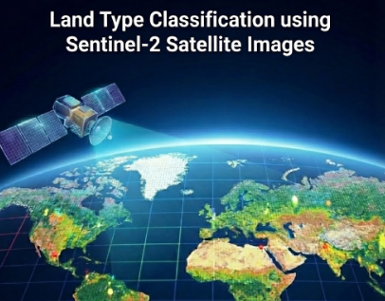

Land Type Classification using Sentinel-2 Satellite Images
1- Tadrous Adel William
2- Maria Ashraf Haleem
3- Abdelaziz Hassan Fouad
4- Karen Medhat Zaher
5- Mohamed Essam
6- Mohamed Kamal

Slide 2
1. Brief description of the problem being solved:
Traditional remote sensing methods rely on manual feature extraction, which is time-consuming and limited in handling the high dimensionality of multispectral data, hindering effective urban planning and resource management.
2. Overview of the proposed solution (high-level idea):
An automated, high-accuracy land classification system leveraging Deep Neural Networks (specifically EfficientNet-B0) to analyze Sentinel-2 satellite imagery and categorize land cover into 10 distinct classes (e.g., Agricultural Land, Urban Areas, Water Bodies)
3. Unique value proposition (Explain what makes your project stand out):
The solution achieved an outstanding test accuracy of 97.12% by utilizing EfficientNet-B0, which offers superior efficiency and a low computational footprint compared to traditional baselines, enabling scalable real-world deployment

Slide 3
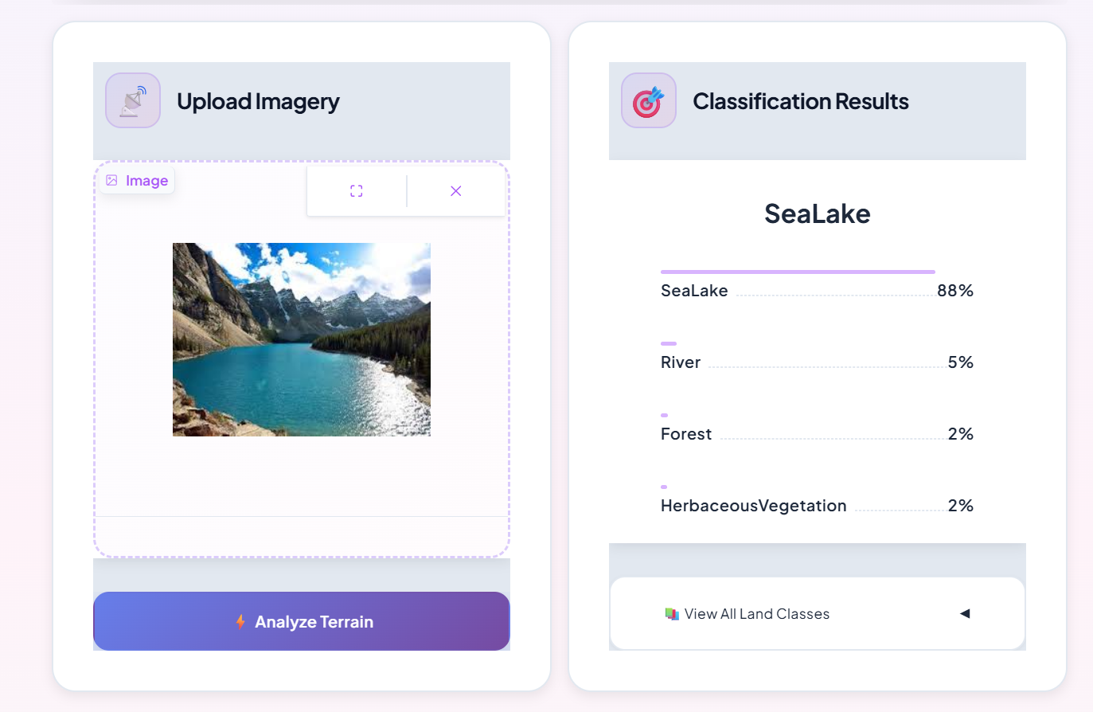
Overview of User Journey:
1- Input: Users upload satellite imagery via drag-and-drop or select from pre-loaded examples.
2- Action: Clicking the "⚡ Analyze Terrain" button triggers the PyTorch backend for immediate inference.
3- Result: The model displays the predicted land type along with confidence scores for the top classes in a clear, graphical format.
Focus on Usability:
The interface prioritizes accessibility with a clean, intuitive design, visual feedback cues, and no-code interaction, making advanced AI analysis accessible to urban planners and researchers.

Slide 4
Primary User Personas:
Urban Planners & Development Agencies.
Agricultural Authorities (Ministry of Agriculture).
Environmental Researchers & Disaster Response Teams.
Key Features:
Multi-Class Classification: Accurately identifies 10 distinct land cover types (e.g., Forests, Crops, Urban areas, Water bodies)
Real-Time Analysis: An interactive web interface that processes satellite imagery and delivers instant predictions.
Precision Metrics: Displays confidence scores for each prediction to support reliable decision-making.
Solving User Problems:
Eliminates the time and cost associated with traditional manual surveying and feature extraction.
Empowers officials with actionable intelligence for monitoring crop health, tracking deforestation, and planning infrastructure effectively.

Slide 5
Database Architecture (CSV):
The dataset is organized using a CSV file that acts as a relational index, mapping each Image Path to its corresponding Class Label
Data Shape & Balance:
Shape: The dataset encompasses 10 land cover classes.
Balance: The data is perfectly balanced (approx. 2,000 images per class), ensuring no class bias during the training phase.
Data Flow & Techniques:
Techniques: The pipeline reads paths from the CSV, applies Preprocessing (Resizing to 224x224) and Data Augmentation (e.g., flips/rotations) before model input.
Evolution: The CSV initially facilitated feature extraction for traditional ML baselines (e.g., Random Forest), before shifting to raw image processing with EfficientNet-B0 for superior deep learning results.

Slide 6
Main Programming Languages:
Python: The core language for the entire data pipeline and AI model development.
Frameworks & Tools:
PyTorch: The primary deep learning framework used to construct and train the EfficientNet-B0 architecture.
Gradio: Utilized to build the modern, interactive web interface for real-time model inference.
Supporting Technologies:
Hugging Face Spaces: Used for cloud hosting and scalable deployment of the application.
Data Libraries: NumPy & Pandas for data manipulation, along with OpenCV/PIL for advanced image preprocessing.

Slide 7
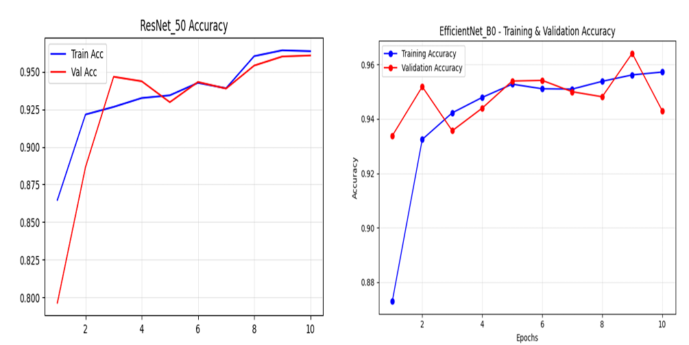
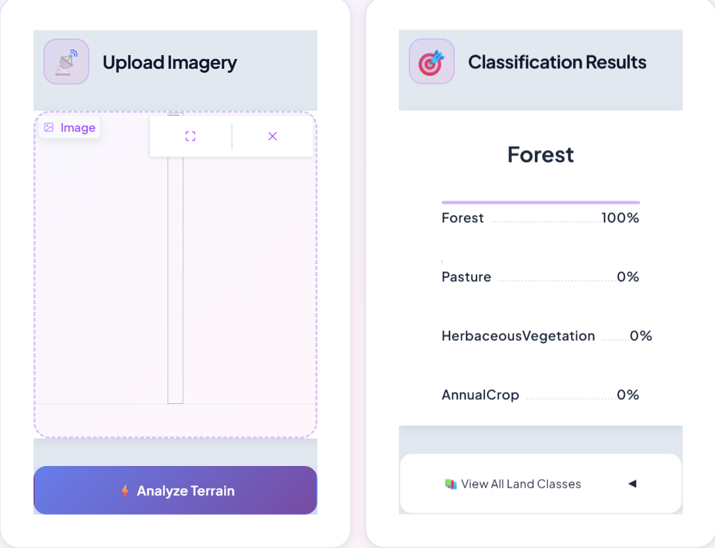
Live Application State:
A functional Beta prototype is deployed on Hugging Face Spaces using Gradio (shown bottom-left), enabling real-time inference where users can upload imagery and receive instant classification
Testing & Benchmarking:
We conducted rigorous comparative testing (top-left charts) between different architectures like ResNet-50 and our final EfficientNet-B0
The training curves demonstrate that EfficientNet-B0 achieved faster convergence and superior stability compared to other models
Final Results:
The system achieved an outstanding 97.12% Test Accuracy, validating the model's robustness and its ability to generalize well on unseen satellite data

Slide 8
List of Reports:
Technical Report: A comprehensive document detailing the preprocessing pipeline, EfficientNet-B0 architecture, and hyperparameter tuning results
Project Documentation: Covers the implementation strategy and user guidelines for the deployed interface
Timeline (Milestones):
Successfully executed the rigorous 5-Milestone Structure:
M1 & M2: Data Collection, Preprocessing, and Advanced Analysis
M3: Model Development and Training Optimization
M4 & M5: Deployment (MLOps) and Final Evaluation
Other Final Products:
Functional Web Application: A live, interactive interface deployed for real-time land classification
Source Code Repository: Complete codebase for data pipeline and model inference
Trained Model Weights: The final optimized EfficientNet-B0 model file ready for production

Slide 9
Core Team & Responsibilities:
Tadrous Adel (Leader): Project management and lead for Deployment/MLOps (Integration & Interface)
Maria Ashraf: Development of Data Preprocessing pipelines and Data Augmentation strategies
Abd-elaziz Hassan: Baseline Model development and rigorous Model Evaluation (F1, Precision, Recall)
Karen Medhat: Primary Data Exploration (EDA) and Spectral Band Analysis for feature selection
Mohamed Essam: Implementation of EfficientNet-B0, Hyperparameter Tuning, and training optimization
Mohamed Kamal: Final Project Documentation, reporting, and defining real-world applications
Collaboration Methods:
Success was achieved through a clear division of labor, ensuring dedicated expertise for each project milestone

Slide 10
Thank you
Email: tadoadel2005@gmail.com
We are now open to any questions or feedback you may have

